Slide 1
Learning Outcomes
Understand Rapid Prototyping
Key technology of Rapid Prototyping

Slide 2
Rapid Prototyping
Rapid Prototyping technology employs various engineering e.g. computer control and software techniques including laser, optical scanning, photosensitive polymers, material extrusion and deposition, powder metallurgy etc. to directly produce a physical model layer by layer (Layer Manufacturing) in accordance with the geometrical data delivered from a 3D CAD model

Slide 3
Rapid Prototyping
Rapid Prototyping is basically a additive manufacturing process used to quickly fabricate a model of a part using 3-D CAM data. It can be defined as layer by layer fabrication of 3D physical models directly from CAD.
https://www.youtube.com/watch?v=zeI0OpaSoc0

Slide 4
Why Rapid Prototyping?
The reasons of Rapid Prototyping are
• To increase effective communication.
• To decrease development time.
• To decrease costly mistakes.
• To minimize sustaining engineering changes.
• To extend product lifetime by adding necessary features and eliminating redundant features
early in the design
Notes:
Six Sigma is a rigorous and a systematic methodology that utilizes information (management by facts) and statistical analysis to measure and improve a company's operational performance, practices and systems by identifying and preventing 'defects' in manufacturing and service-related processes in order to anticipate and exceed expectations of all stakeholders to accomplish effectiveness.

Slide 5
How does Rapid Prototyping Work?
Rapid Prototyping, also known as 3D printing, is an additive manufacturing technology. The process begins with taking a virtual design from modeling or computer aided design (CAD) software. The 3D printing machine reads the data from the CAD drawing and lays down successive layers of liquid, powder, or sheet material — building up the physical model from a series of cross sections. These layers, which correspond to the virtual cross section from the CAD model, are automatically joined together to create the final shape. Rapid Prototyping uses a standard data interface, implemented as the STL file format, to translate from the CAD software to the 3D prototyping machine. The STL file approximates the shape of a part or assembly using triangular facets
Notes:
Six Sigma is a rigorous and a systematic methodology that utilizes information (management by facts) and statistical analysis to measure and improve a company's operational performance, practices and systems by identifying and preventing 'defects' in manufacturing and service-related processes in order to anticipate and exceed expectations of all stakeholders to accomplish effectiveness.

Slide 6
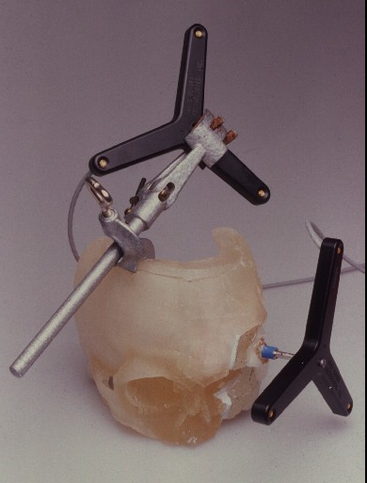
Stereolithorgraphy
Notes:
Six Sigma is a rigorous and a systematic methodology that utilizes information (management by facts) and statistical analysis to measure and improve a company's operational performance, practices and systems by identifying and preventing 'defects' in manufacturing and service-related processes in order to anticipate and exceed expectations of all stakeholders to accomplish effectiveness.

Slide 7
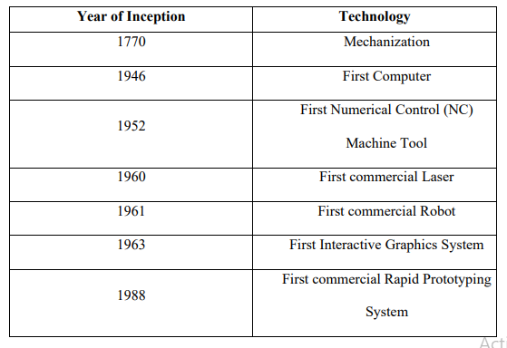
HISTORICAL DEVELOPMENT
Notes:
Six Sigma is a rigorous and a systematic methodology that utilizes information (management by facts) and statistical analysis to measure and improve a company's operational performance, practices and systems by identifying and preventing 'defects' in manufacturing and service-related processes in order to anticipate and exceed expectations of all stakeholders to accomplish effectiveness.

Slide 8
FUNDAMENTALS OF RAPID PROTOTYPING
a) A model or component is modelled on a Computer-Aided Design/Computer-Aided Manufacturing (CAD/CAM) system. The model which represents the physical part to be built must be represented as closed surfaces which unambiguously define an enclosed volume. This mean that the data must specify the inside, outside and boundary of the model. This requirement ensures that all horizontal cross sections that are essential to RP are enclosed curves to create the solid object
Notes:
Six Sigma is a rigorous and a systematic methodology that utilizes information (management by facts) and statistical analysis to measure and improve a company's operational performance, practices and systems by identifying and preventing 'defects' in manufacturing and service-related processes in order to anticipate and exceed expectations of all stakeholders to accomplish effectiveness.

Slide 9
FUNDAMENTALS OF RAPID PROTOTYPING
b) The solid or surface model to be built is next converted into a format dubbed the “STL” (Stereolithography) file format which originates from 3D systems. The STL file format approximates the surfaces of models by polygons. Highly curved surfaces must employ many polygons, which means that STL files for curved parts can be very large. However, these are some rapid prototyping systems which also accept IGES (Initial Graphics Exchange Specifications) data, provided it is of the correct “flavour”.
Notes:
Six Sigma is a rigorous and a systematic methodology that utilizes information (management by facts) and statistical analysis to measure and improve a company's operational performance, practices and systems by identifying and preventing 'defects' in manufacturing and service-related processes in order to anticipate and exceed expectations of all stakeholders to accomplish effectiveness.

Slide 10
FUNDAMENTALS OF RAPID PROTOTYPING
c) A computer program analyzes a STL file that defines the model to be fabricated and “slices” the model into cross sections. The cross sections are systematically recreated through the solidification of either liquids or powders and then combined to form a 3D model. Another possibility is that the cross sections are already thin, solid laminations and these thin laminations are glued together with adhesives to form a 3D model. Other similar methods may also be employed to build the model

Slide 11
INPUT
Input refers to the electronic information required to describe the physical object with 3D data. These are two possible starting points- a computer model or a physical model. The computer model created by a CAD system can be either a surface model or a solid model. On the other hand, 3D data from the physical model is not at all straight forward. It requires data acquisition through a method known as reverse engineering. In reverse engineering, a wide range of equipment can be used, such as CMM (coordinate measuring machine) or a laser digitizer, to capture data points of the physical model and “reconstruct” it in a CAD system.

Slide 12
APPLICATION:
RAPID TOOLING
• Patterns for Sand Casting
• Patterns for Investment Casting
• Pattern for Injection moldings

Slide 13
APPLICATION:
RAPID MANUFACTURING
• Short productions run
• Custom made parts
• On-Demand Manufacturing
• Manufacturing of very complex shapes

Slide 14
APPLICATION:
AEROSPACE & MARINE
• Wind tunnel models
• Functional prototypes
• Boeing’s On-Demand-Manufacturing
AUTOMOTIVE RP SERVICES
• Needed from concept to production level
• Reduced time to market
• Functional testing
• Dies & Moulds

Slide 15
APPLICATION:
BIOMEDICAL APPLICATIONS - I
• Prosthetic parts
• Use of data from MRI and CT scan to build 3D parts
• 3D visualization for education and training
BIOMEDICAL APPLICATIONS - II
• Customized surgical implants
• Mechanical bone replicas
• Anthropology
• Forensics

Slide 16
APPLICATION:
ARCHITECTURE
• 3D visualization of design space
• Iterations of shape
• Sectioned models
FASHION & JEWELRY
• Shoe Design
• Jewellery
• Pattern for lost wax
• Other castings

Slide 17
Classification of Rapid Prototyping System
LIQUID-BASED
• Stereo lithography (SLA)
• Solid Ground Curing (SGA)
SOLID-BASED
• Fused deposition modeling (FDM)
• Laminated object manufacturing (LOM)
POWDER-BASED
• 3D Printing
• Selective laser sintering (SLS)
• Direct metal laser sintering (DMLS)

Slide 18
Limitations of Rapid prototyping
 High precision RP machines are still expensive.
 RP systems are difficult to build parts with accuracy under +/- 0.02mm and wall thickness under 0.5mm.
 The physical properties of the RP parts are normally inferior to those samples that made in proper materials and by the traditional tooling.
 The RP parts are not comparable to (CNC) prototype parts in the surface finishing, strength, elasticity, reflective index and other material physical properties.

Slide 19
Workflow of RP processes
All RP techniques employ the basic five-steps processes:
Create a CAD model of the design.
Convert the CAD model to STL format.
Slice the STL file into thin cross-sectional layers.
Construct the model one layer atop another.
Clean and finish the model.

Slide 20
Workflow of RP processes
Pre process RP process
CAD model
Post process
Surface/Solid model
Generate STL file
Build prototype
Remove supports
Build supports if needed
Clean the surface
Slicing
Post cure
Part completed

Slide 21
1. CAD Model Creation
 First, the object to be built is modeled using a Computer-Aided Design (CAD) software package.
Solid modelers, such as Pro/ENGINEER, tend to represent 3-D objects more accurately than wire-frame modelers such as AutoCAD, and will therefore yield better results.
This process is identical for all of the RP build techniques.

Slide 22
2. Conversion to STL Format

 To establish consistency, the STL format has been adopted as the standard of the rapid prototyping industry.
 The second step, therefore, is to convert the CAD file into STL format. This format represents a three-dimensional surface as an assembly of planar triangles
 STL files use planar elements, they cannot represent curved surfaces exactly. Increasing the number of triangles improves the approximation
https://www.youtube.com/watch?v=yW4EbCWaJHE

Slide 23

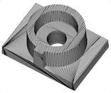

Example of STL model
This figure shows a typical example of STL model which is composed of triangles and each triangle is described by a unit normal vector direction and three points representing the vertices of the triangle.
https://www.youtube.com/watch?v=1IIYZloCPSA
https://www.youtube.com/watch?v=_5XfHAjk0Xs

Slide 24
3. Slice the STL File

 In the third step, a pre-processing program prepares the STL file to be built.
 The pre-processing software slices the STL model into a number of layers from 0.01 mm to 0.7 mm thick, depending on the build technique.
 The program may also generate an auxiliary structure to support the model during the build. Supports are useful for delicate features such as overhangs, internal cavities, and thin-walled sections.

